Slide 1
Week 3
Assignment：Load Balancing
Name：张颜兵
Id：12132428
Department：MAE
SuperVisor：Prof.吴雷
Research Topic：Engineering calculation

Slide 2




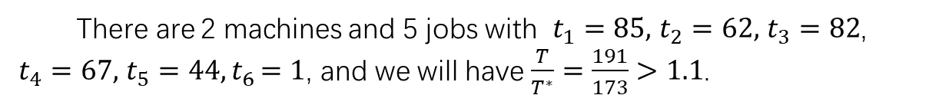





E1
你好There are 2 machines and 5 jobs with $t_{1}=85,$ $t_{2}=62,$ $t_{3}=82$, $t_{4}=67,$ $t_{5}=44{,t}_{6}=1$, and we will have $\frac{T}{T^{∗}}=\frac{191}{173}>1.1$.
$$Sorted Greedy$$
$$Optimal$$
$$t_{1}=85,t_{4}=62,t_{5}=44$$
$$t_{1}=85,t_{3}=82,t_{6}=1$$
M1
M1
$t_{2}=82,$ $t_{3}=67,t_{6}=1$
$t_{2}=62,$ $t_{4}=67,t_{5}=44$
M2
M2
$T=\max\left\{211,150\right\}=191$；
$T^{∗}=\max\left\{173,168\right\}=173$；

Slide 3
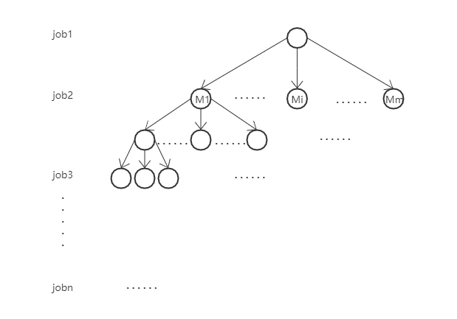
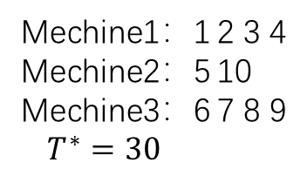
E2
The first kind of algorithm：characterize the problem as a complete m tree
Mechine1：1 2 3 4
Mechine2：5 10
Mechine3：6 7 8 9
$T^{∗}=30$
Number of operations：
num=59049 //before adding constraints
num=16741 //after adding constraints
完全m叉树

Slide 4
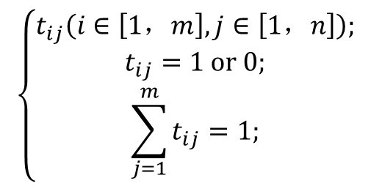
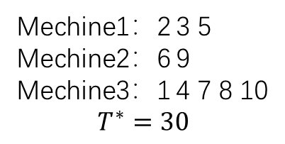
E2
The second kind of algorithm：use genetic algorithm to get the optimal makespan
Parameter settings：
const int MEA=10000;//Maximum evolutionary algebra
const int PN=100; //Population number
const double CP=0.6; //Crossover probability
const double MP=0.3; //Mutation probability
const int N=110; //Maximum chromosome length
const int M=50; //Maximum number of working machines
Load balancing data structure：
$$\left\{\begin{aligned}t_{ij}\left(i∈\left[1，m\right],j∈\left[1，n\right]\right); \\ t_{ij}=1 or 0; \\ \sum_{j=1}^{m}{t_{ij}=1;}\end{aligned}\right.$$
Mechine1：2 3 5
Mechine2：6 9
Mechine3：1 4 7 8 10
$$T^{∗}=30$$
Average number of iterations is 112.

